Slide 1
Queue

Slide 2
Queues
Queue is somewhat similar to stack.
Unlike stacks, a queue is open at both its ends.
One end is always used to insert data.
The other is used to remove data.

Slide 3
Queue
In a queue, the element deleted from the list is the one which inserted first.
Queue is also referred as First-in First-out i.e FIFO.
The example of queue is the queue of people standing for submitting their bills in the bank. The one who joins the queue first also leaves the queue first . Similarly who joins the queue at last, leaves the queue at last.

Slide 4
Enqueue & Dequeue
If an empty queue is deleted, we say queue underflows and
If rear of the queue exceeds n, the queue overflows.
Insertion to queue is called Enqueue and deletion form queue is called Dequeue.

Slide 5
Queue using Array
If we use an array to hold queue elements, both insertions and removal at the front (start) of the array are expensive.
This is because we may have to shift up to “n” elements.
For the stack, we needed only one end; for queue we need both.
To get around this, we will not shift upon removal of an element.

Slide 6
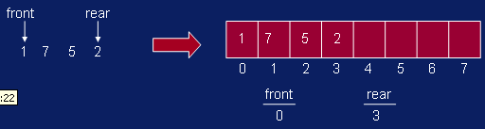
Queue using Array

Slide 7
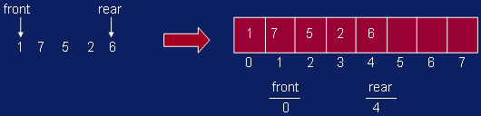
Queue using Array

Slide 8
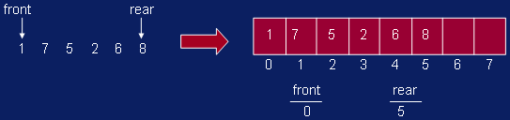
Queue using Array

Slide 9
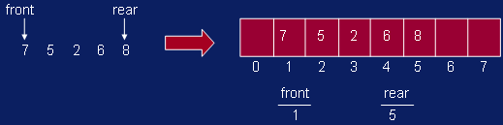
Queue using Array

Slide 10
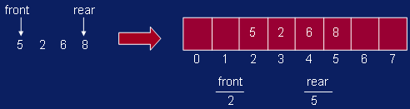
Queue using Array

Slide 11
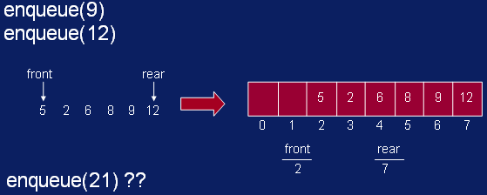
Queue using Array

Slide 12
Queue using Array
We have inserts and removal running in constant time but we created a new problem.
Cannot insert new elements even though there are two places available at the start of the array.
Solution: allow the queue to “wrap around”.

Slide 13
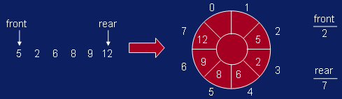
Queue using Array
Basic idea is to picture the array as a circular array.

Slide 14
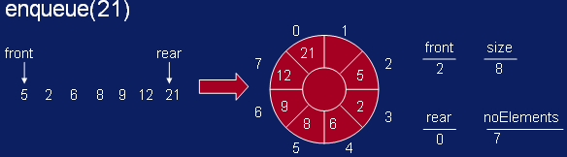
Queue using Array

Slide 15
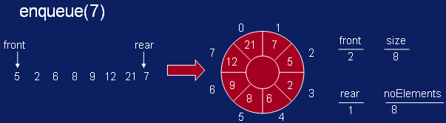
Queue using Array

Slide 16
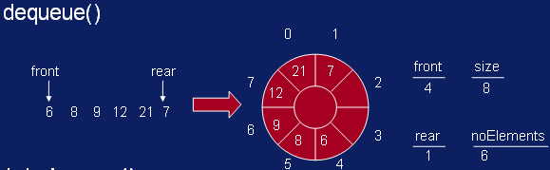
Queue using Array

Slide 17
thanks

